Slide 1

Does Learning Require Memorization?
A short tale about a long tail
_{Vitaly Feldman}
_{Research}
_{Brain team}

Slide 2
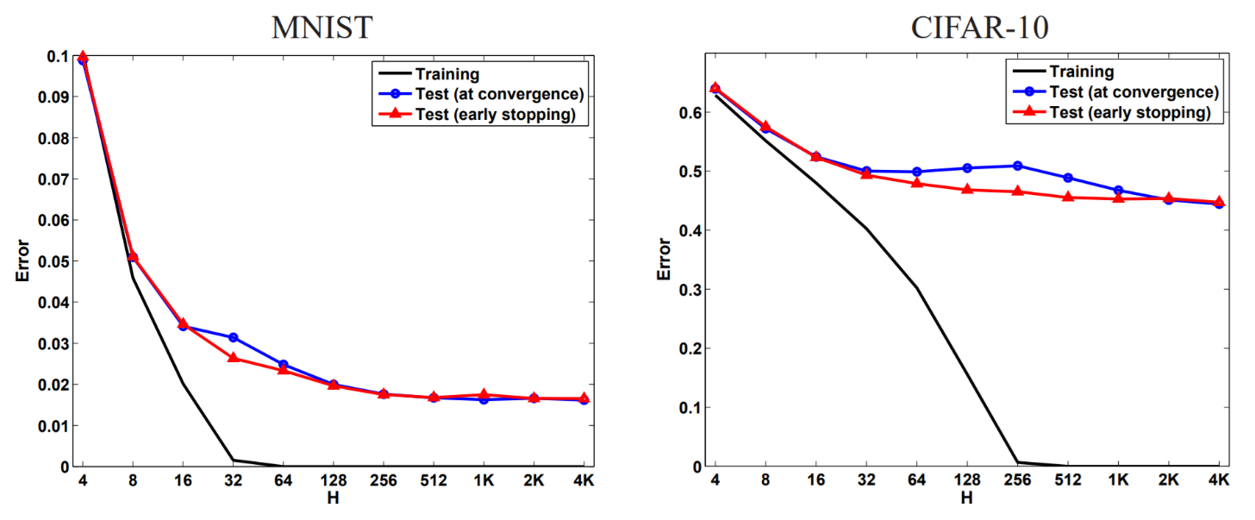
(Over?)fitting the dataset
[Neyshabur,Tomioka,Srebro ‘15]
Inception on Imagenet 1000 with random labels:
Training error: 9% Test error: 99.9%
[Zhang,Bengio,Hardt,Recht,Vinyals ‘17]

Slide 3
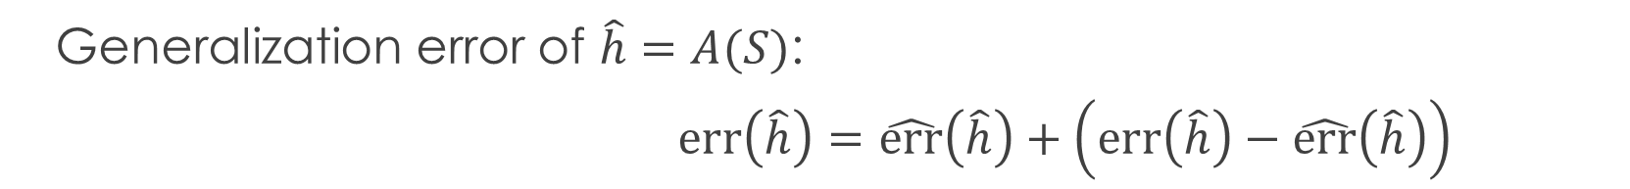


What about theory?
Generalization error of $\hat{h}=A(S)$:
$err\left(\hat{h}\right)=\hat{err}\left(\hat{h}\right)+\left(err\left(\hat{h}\right)−\hat{err}\left(\hat{h}\right)\right)$
empirical
error
generalization gap
$$≥$$
Proxy: VC-dim, Rademacher complexity, stability, etc
Standard approach: $\hat{h}=argmin\left\{\hat{err}\left(\hat{h}\right)+λ⋅proxy\left(\hat{h},S\right)\right\}$ for $λ≥1$
To fit noise/outliers need $λ≤1$!
Why are modern ML algorithms tuned to memorize labels?
Notes:
Mention old phenomena
Mention privacy

Slide 4
Related questions
Bounds on the generalization gap for DNNs
Norm/margin-based, stabiIity, description length, PAC-Bayes etc.
Implicit/algorithmic regularization
Generalization of interpolating methods
Interpolation may be “harmless”
Does not address the “why?” question
Memorization also happens without interpolation
Advantages of interpolation
Overparametrization is useful
Does not imply interpolation
SGD converges faster on some convex realizable problems
Little empirical support in the context of DNNs
[Schapire,Freund,Bartlett,Lee ’98;
Neyshabur,Tomioka,Srebro ’15; ….]
[Cover,Hart ’67; Belkin,Hsu,Mitra ‘18;
Liang,Rakhlin ’18; Belkin,Rakhlin,Tsybakov ’19;
Belkin,Hsu,Xu ’19; Bartlett,Long,Lugosi,Tsigler ‘19;
Hastie,Montanari,Rosset,Tibshirani ’19;
Muthukumar,Vodrahalli,Sahai ‘19….]
[Ma,Bassily,Belkin ’18]

Slide 5
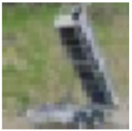
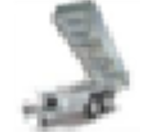

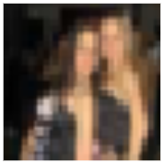

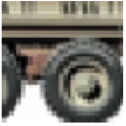
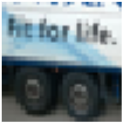
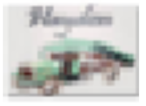
Hard rare examples
CIFAR-10 truck class
training set
test set
Notes:
Note: order

Slide 6
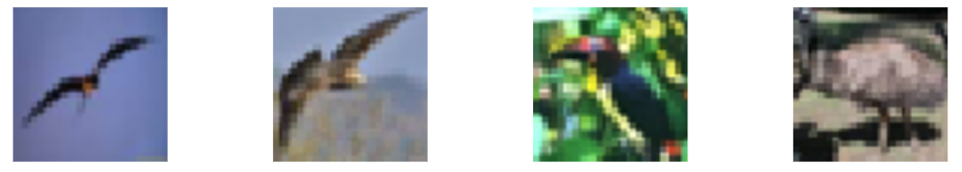
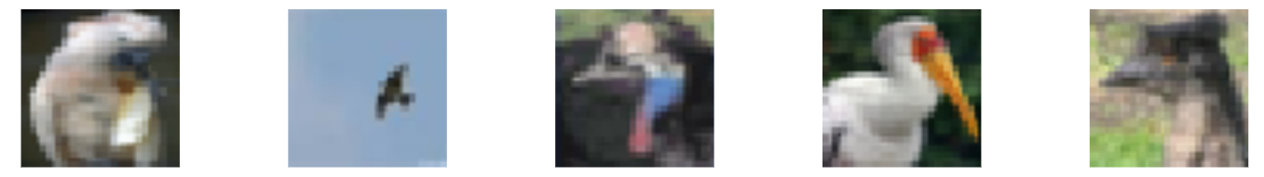
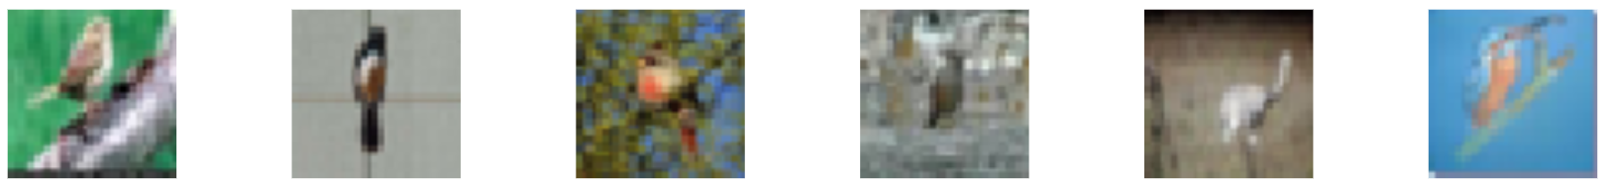
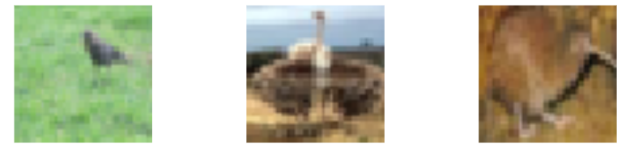
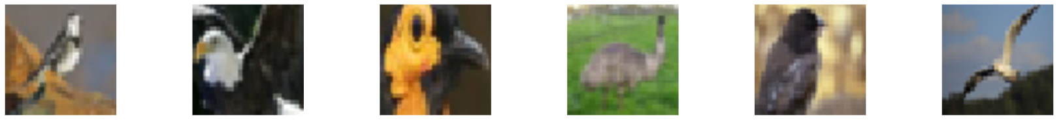
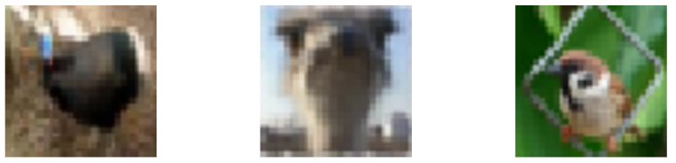
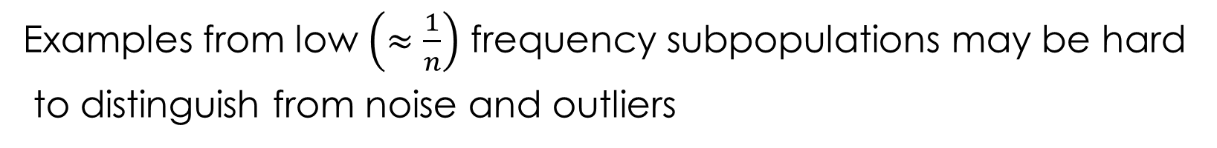
Subpopulations
CIFAR-10 birds
Examples from low $\left(≈\frac{1}{n}\right)$ frequency subpopulations may be hard
to distinguish from noise and outliers

Slide 7
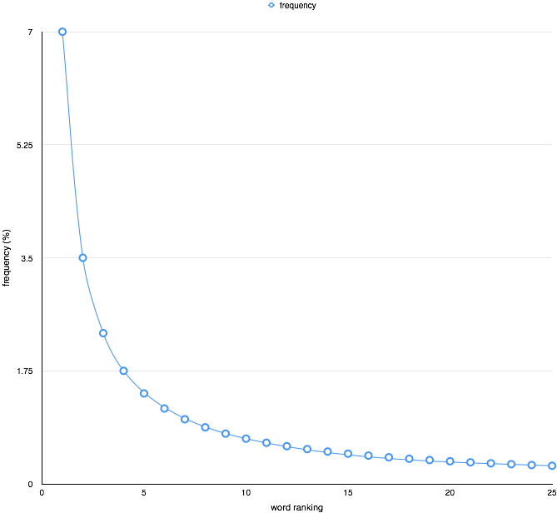
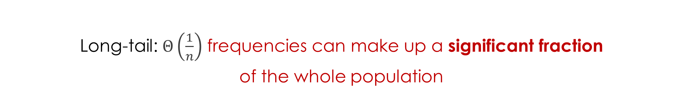
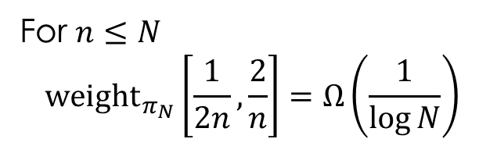
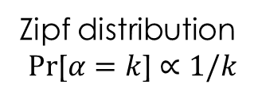
The tail rears its head
Long-tail: $Θ\left(\frac{1}{n}\right)$ frequencies can make up a significant fraction
of the whole population
For $n≤N$
$$\underset{}{{weight}_{π_{N}}}\left[\frac{1}{2n},\frac{2}{n}\right]=Ω\left(\frac{1}{\log{N}}\right)$$
Zipf distribution
$$Pr\text{[}α=k\text{]}∝1/k$$

Slide 8
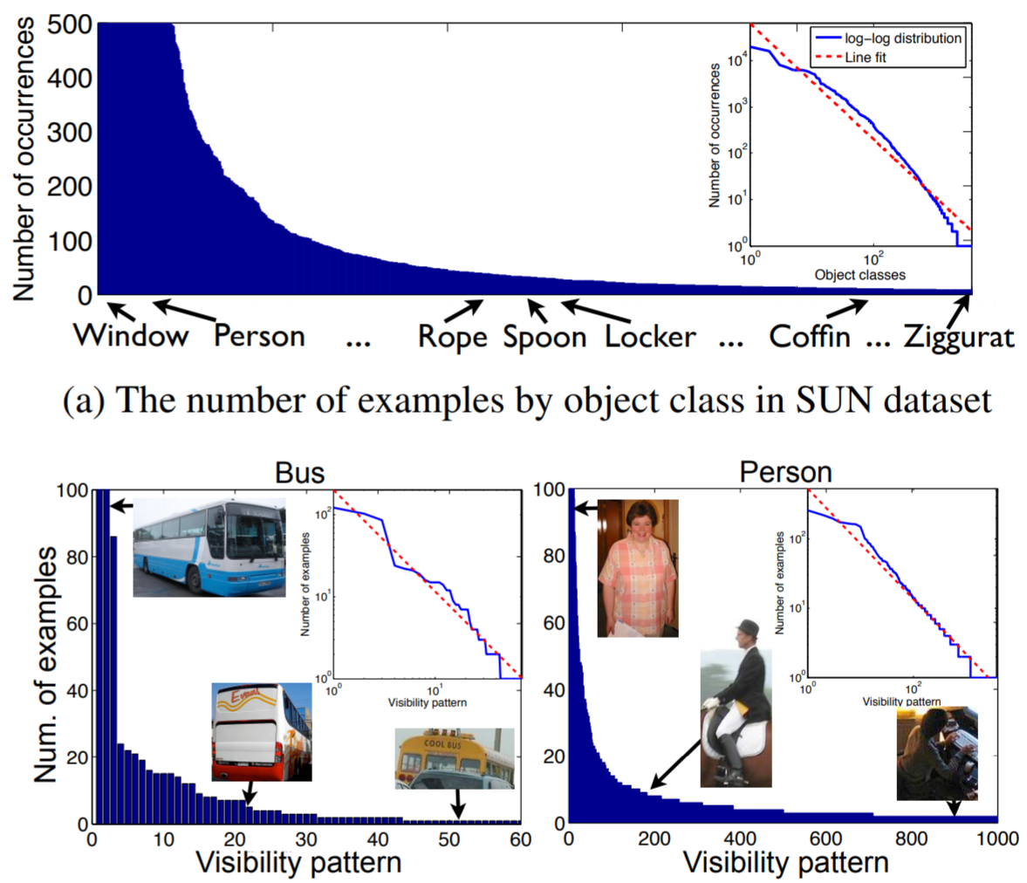
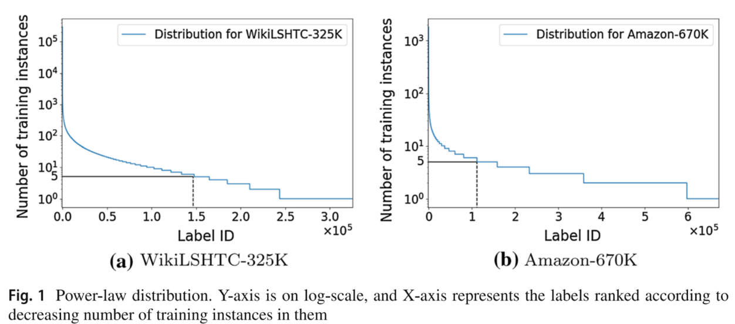
Long-tailed data
Additional annotations
Extreme multiclass problems
[Zhu, Anguelov, Ramanan ’14]
[Babbar,Scholkopf ‘19]

Slide 9
Privacy and memorization
Differentially private algorithms cannot memorize rare examples or fit noise
Do not achieve state-of-the-art error: e.g. 2% on MNIST vs 0.2% non-privately
least accurate
most accurate
[Carlini,Erlingsson,Papernot ’18]

Slide 10
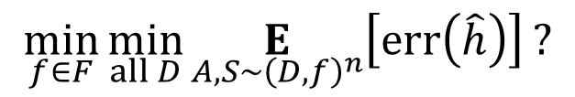
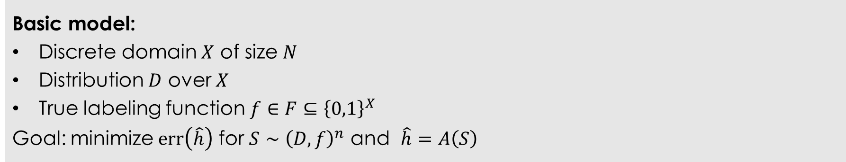
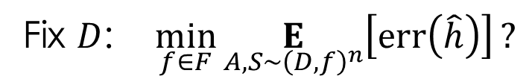
Model
Basic model:
Discrete domain $X$ of size $N$
Distribution $D$ over $X$
True labeling function $f∈F⊆{\left\{0,1\right\}}^{X}$
Goal: minimize $err\left(\hat{h}\right)$ for $S∼{\left(D,f\right)}^{n}$ and $\hat{h}=A\left(S\right)$
$$\min_{f∈F}{\min_{all D}{\underset{A, S∼{\left(D,f\right)}^{n}}{E}\left[err\left(\hat{h}\right)\right]}}?$$
Fix $D$: $\min_{f∈F}{\underset{A, S∼{\left(D,f\right)}^{n}}{E}\left[err\left(\hat{h}\right)\right]}?$

Slide 11
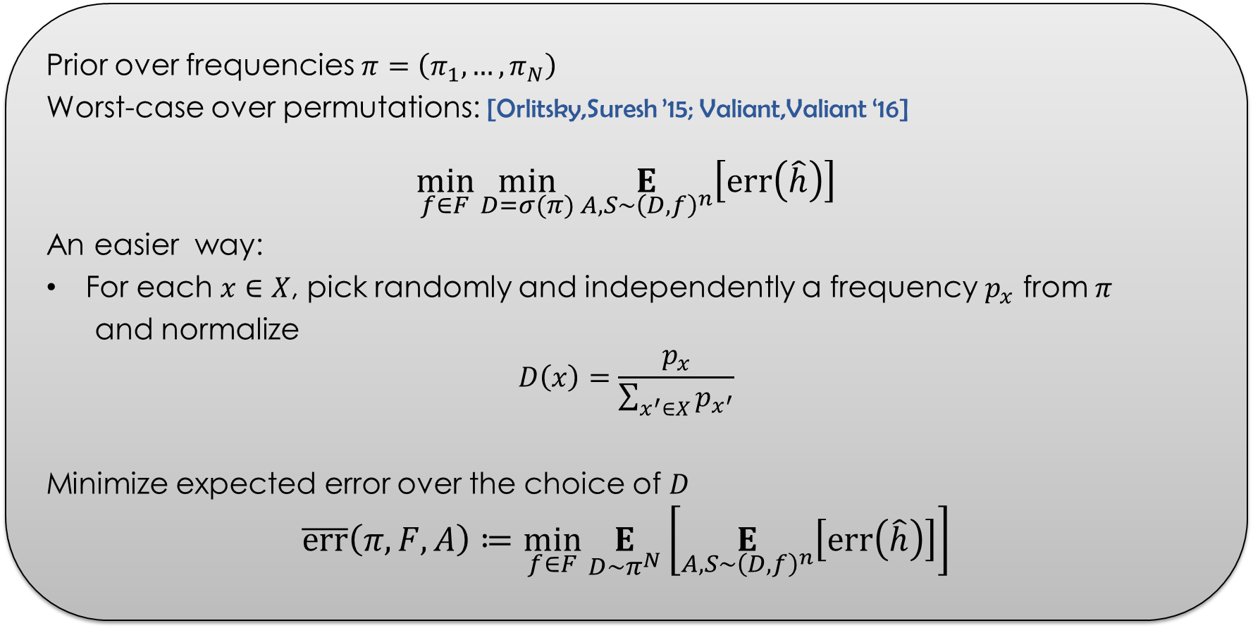
Error
Prior over frequencies $π=\left(π_{1},…,π_{N}\right)$
Worst-case over permutations: [Orlitsky,Suresh ’15; Valiant,Valiant ‘16]
$$\min_{f∈F}{\min_{D=σ(π)}{\underset{A, S∼{\left(D,f\right)}^{n}}{E}\left[err\left(\hat{h}\right)\right]}}$$
An easier way:
For each $x∈X$, pick randomly and independently a frequency $p_{x}$ from $π$
and normalize
$$D\left(x\right)=\frac{p_{x}}{\sum_{x^{′}∈X}{p_{x^{′}}}}$$
Minimize expected error over the choice of $D$
$$\overline{err}\left(π,F,A\right)≔\min_{f∈F}\underset{D∼π^{N}}{E}\left[\underset{A, S∼{\left(D,f\right)}^{n}}{E}\left[err\left(\hat{h}\right)\right]\right]$$

Slide 12
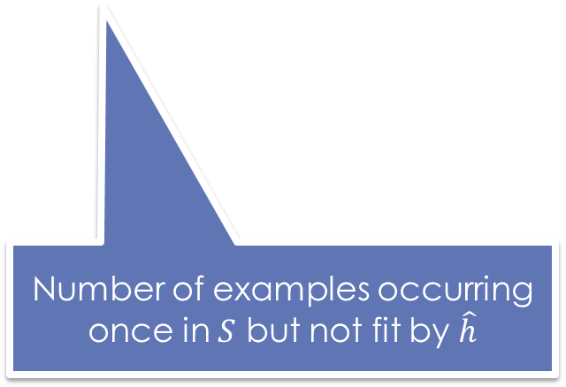
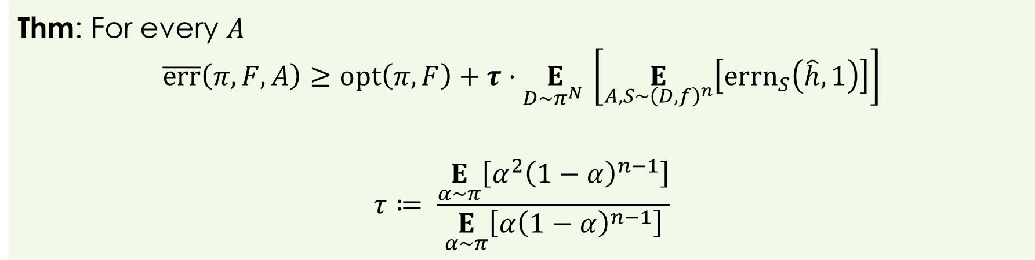
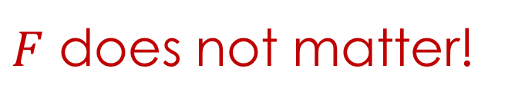
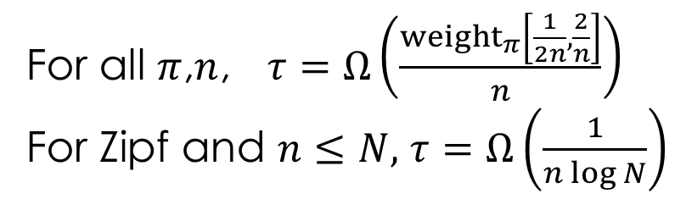
Benefits of fitting
Thm: For every $A$
$$\overline{err}\left(π,F,A\right)≥opt\left(π,F\right)+τ⋅\underset{D∼π^{N} }{E}\left[\underset{A,S∼{\left(D,f\right)}^{n}}{E}\left[{errn}_{S}\left(\hat{h},1\right)\right]\right]$$
$$τ≔ \frac{\underset{α∼π}{E}\left[α^{2}{\left(1−α\right)}^{n−1}\right]}{\underset{α∼π}{E}\left[α{\left(1−α\right)}^{n−1}\right]}$$
Number of examples occurring once in $S$ but not fit by $\hat{h}$
For all $π$,$n$, $τ=Ω\left(\frac{{weight}_{π}\left[\frac{1}{2n},\frac{2}{n}\right]}{n}\right)$
For Zipf and $n≤N,$ $τ=Ω\left(\frac{1}{n\log{N}}\right)$
$F$ does not matter!

Slide 13
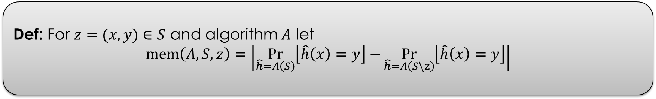
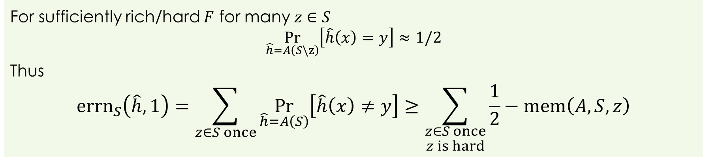
Fitting and memorization
Def: For $z=(x,y)∈S$ and algorithm $A$ let
$$mem\left(A,S,z\right)=\left|\underset{\hat{h}=A\left(S\right)}{Pr}\left[\hat{h}\left(x\right)=y\right]−\underset{\hat{h}=A\left(S\backslash z\right)}{Pr}\left[\hat{h}\left(x\right)=y\right]\right|$$
For sufficiently rich/hard $F$ for many $z∈S$
$$\underset{\hat{h}=A\left(S\backslash z\right)}{Pr}\left[\hat{h}\left(x\right)=y\right]≈1/2$$
Thus
$${errn}_{S}\left(\hat{h},1\right)=\sum_{z∈S once}{\underset{\hat{h}=A\left(S\right)}{Pr}\left[\hat{h}\left(x\right)≠y\right]}≥\sum_{\begin{aligned}z∈S once \\ z is hard\end{aligned}}{\frac{1}{2}−mem\left(A,S,z\right)}$$

Slide 14
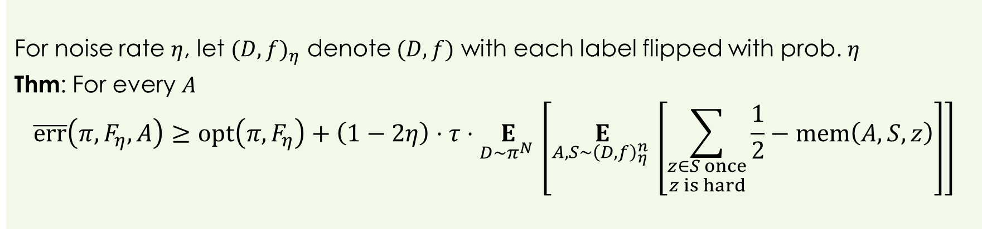
Label noise
For noise rate $η$, let ${(D,f)}_{η}$ denote $(D,f)$ with each label flipped with prob. $η$
Thm: For every $A$
$$\overline{err}\left(π,F_{η},A\right)≥opt\left(π,F_{η}\right)+\left(1−2η\right)⋅τ⋅\underset{D∼π^{N} }{E}\left[\underset{A,S∼{\left(D,f\right)}_{η}^{n} }{E}\left[\sum_{\begin{aligned}z∈S once \\ z is hard\end{aligned}}{\frac{1}{2}−mem\left(A,S,z\right)}\right]\right]$$
Optimal algorithm no longer interpolates $S$

Slide 15
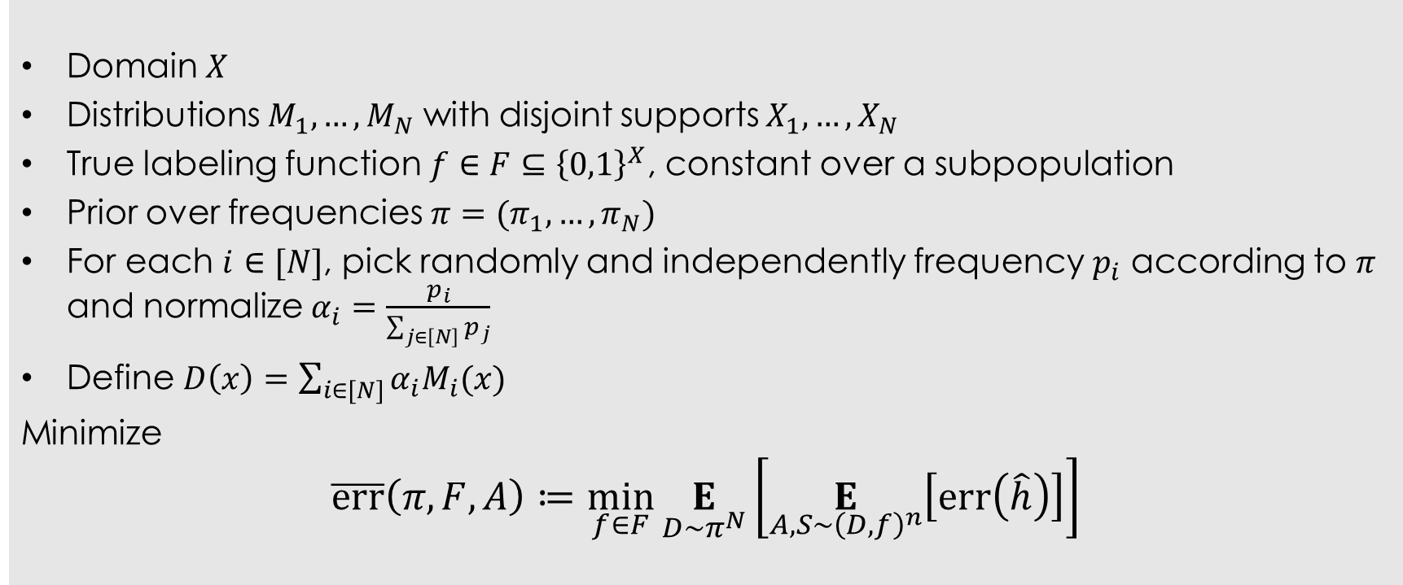
Beyond discrete domains
Domain $X$
Distributions $M_{1},…,M_{N}$ with disjoint supports $X_{1},…,X_{N}$
True labeling function $f∈F⊆{\left\{0,1\right\}}^{X}$, constant over a subpopulation
Prior over frequencies $π=(π_{1},…,π_{N})$
For each $i∈[N]$, pick randomly and independently frequency $p_{i}$ according to $π$ and normalize $α_{i}=\frac{p_{i}}{\sum_{j∈\left[N\right]}{p_{j}}}$
Define $D\left(x\right)=\sum_{i∈[N]}{α_{i}M_{i}(x)}$
Minimize
$$\overline{err}\left(π,F,A\right)≔\min_{f∈F}\underset{D∼π^{N}}{E}\left[\underset{A,S∼{\left(D,f\right)}^{n}}{E}\left[err\left(\hat{h}\right)\right]\right]$$

Slide 16
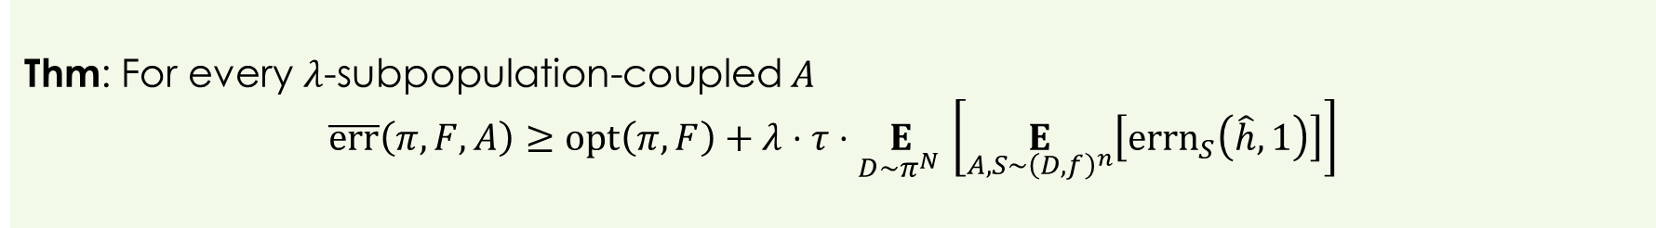
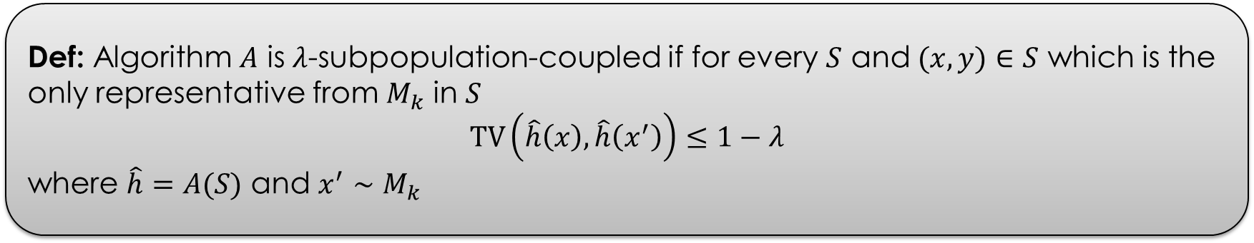
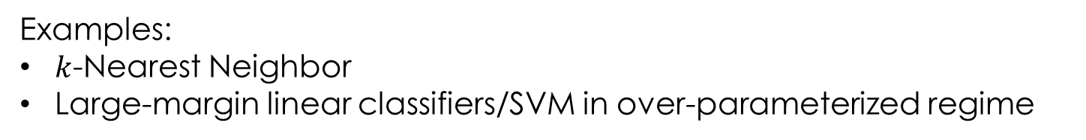
Coupling
Def: Algorithm $A$ is $λ$-subpopulation-coupled if for every $S$ and $(x,y)∈S$ which is the only representative from $M_{k}$ in $S$
$$TV\left(\hat{h}\left(x\right),\hat{h}\left(x^{′}\right)\right)≤1−λ$$
where $\hat{h}=A(S)$ and $x^{′}∼M_{k}$
Thm: For every $λ$-subpopulation-coupled $A$
$$\overline{err}\left(π,F,A\right)≥opt\left(π,F\right)+λ⋅τ⋅\underset{D∼π^{N} }{E}\left[\underset{A,S∼{\left(D,f\right)}^{n}}{E}\left[{errn}_{S}\left(\hat{h},1\right)\right]\right]$$
Examples:
$k$-Nearest Neighbor
Large-margin linear classifiers/SVM in over-parameterized regime

Slide 17

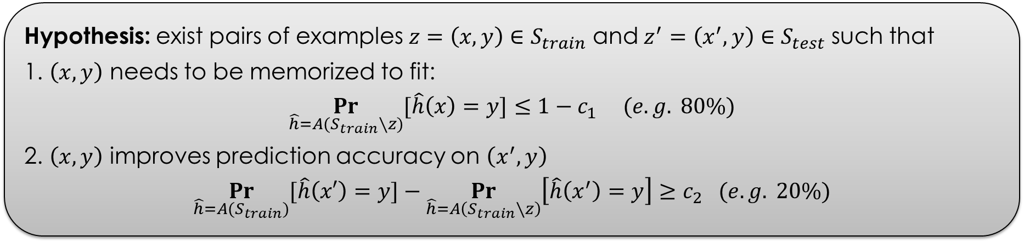
Experiments (with Chiyuan Zhang)
Hypothesis: exist pairs of examples $z=\left(x,y\right)∈S_{train}$ and $z^{′}=\left(x^{′},y\right)∈S_{test}$ such that
1. $\left(x,y\right)$ needs to be memorized to fit:
$$\underset{\hat{h}=A(S_{train}∖z)}{Pr}{[\hat{h}\left(x\right)=y]}≤{1−c}_{1} (e.g. 80\%)$$
2. $\left(x,y\right)$ improves prediction accuracy on $\left(x^{′},y\right)$
$$\underset{\hat{h}=A(S_{train})}{Pr}{[\hat{h}\left(x′\right)=y]}−\underset{\hat{h}=A\left(S_{train}∖z\right)}{Pr}\left[\hat{h}\left(x^{′}\right)=y\right]≥c_{2} (e.g. 20\%)$$
Fraction of such examples is significant
EXAMPLES
FROM THE
LONG TAIL
Computationally prohibitive to find directly
(even on MNIST)

Slide 18
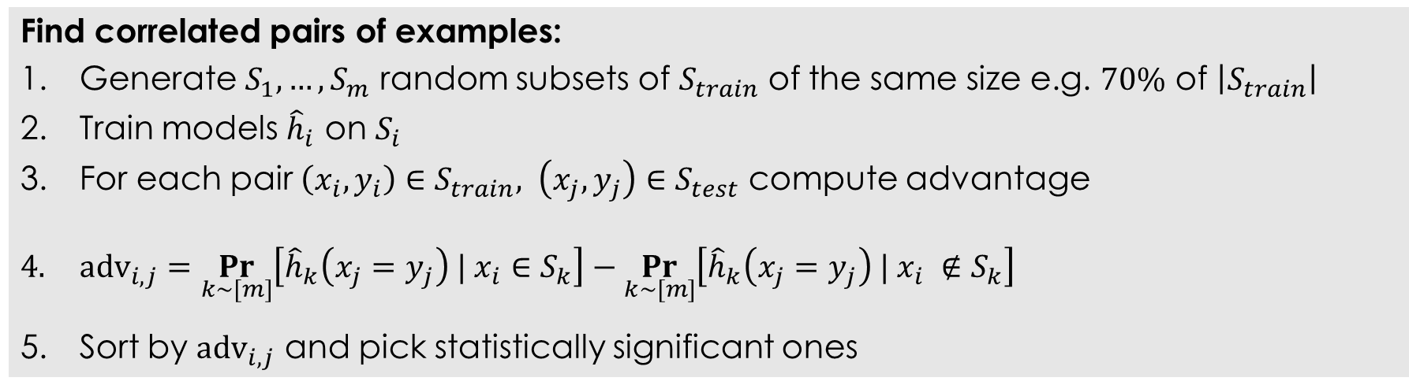
Method
Find correlated pairs of examples:
Generate $S_{1},…,S_{m}$ random subsets of $S_{train}$ of the same size e.g. $70\%$ of $\left|S_{train}\right|$
Train models ${\hat{h}}_{i}$ on $S_{i}$
For each pair $\left(x_{i},y_{i}\right)∈S_{train}, \left(x_{j},y_{j}\right)∈S_{test}$ compute advantage
$adv_{i,j}=\underset{k∼[m]}{Pr}\left[{\hat{h}}_{k}\left(x_{j}=y_{j}\right) | x_{i}∈S_{k}\right]−\underset{k∼[m]}{Pr}\left[{\hat{h}}_{k}\left(x_{j}=y_{j}\right) | x_{i} ∉S_{k}\right]$
Sort by $adv_{i,j}$ and pick statistically significant ones
Still computationally intensive: requires large $m$ (>1,000)

Slide 19
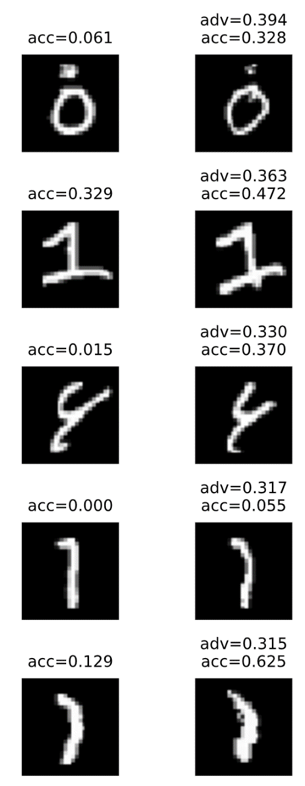
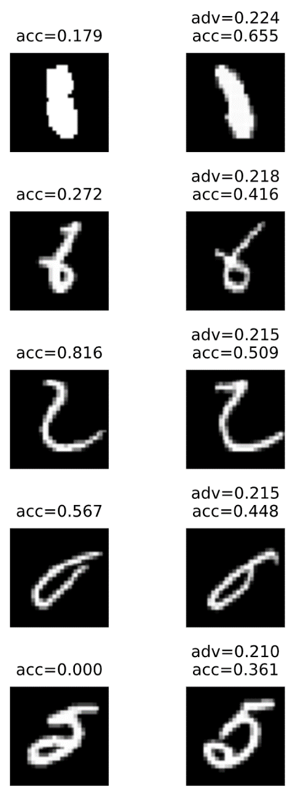
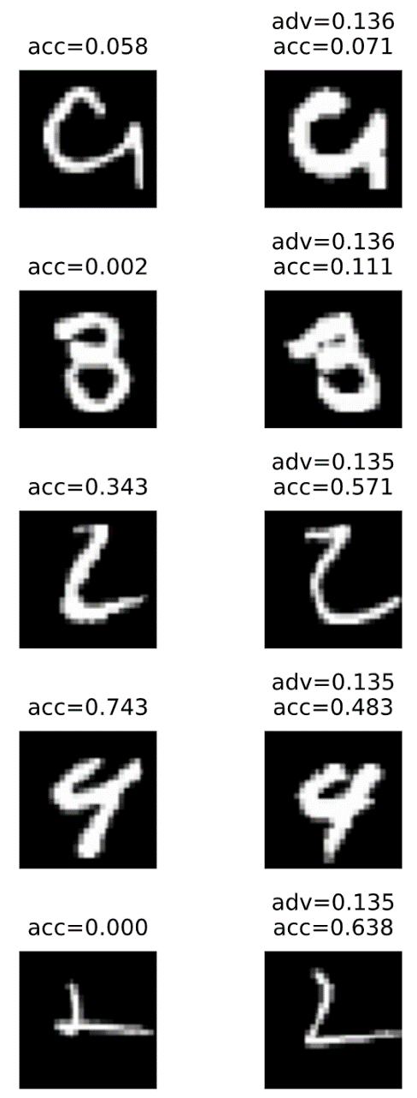
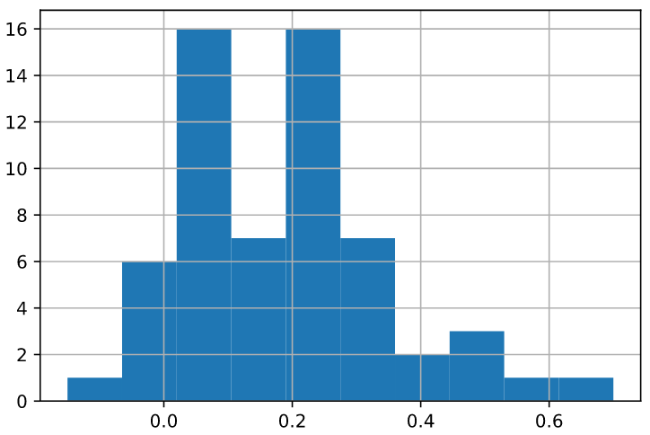
Results (MNIST)
train
test
train
test
train
test
MNIST:
50,000 train; 10,000 test
10 classes
Algo: SGD on simple CNN
99+% accuracy
70+ examples with
>10% advantage

Slide 20
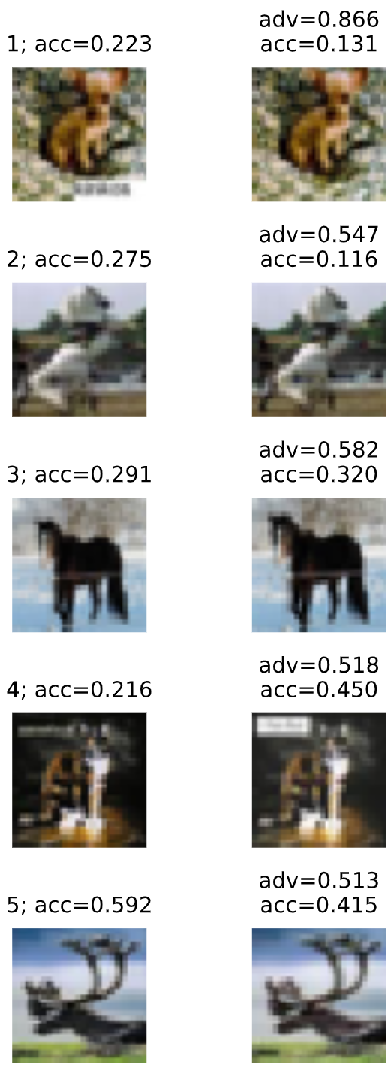
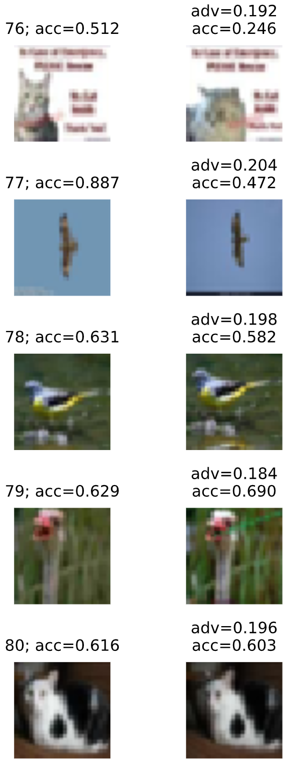
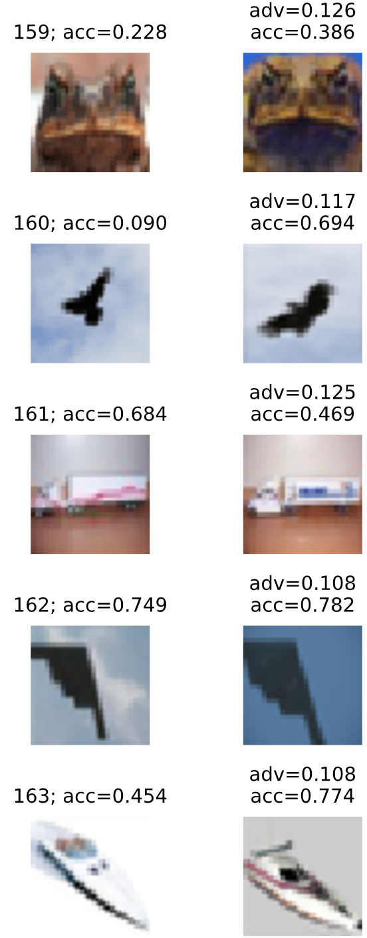
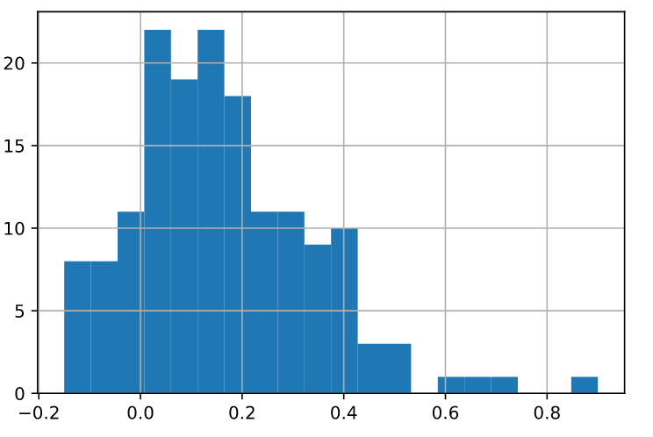
Results (CIFAR-10)
train
test
train
test
train
test
CIFAR-10:
50,000 train; 10,000 test
10 classes
Algo: SGD on Inception
87% accuracy
170+ examples with
>10% advantage

Slide 21
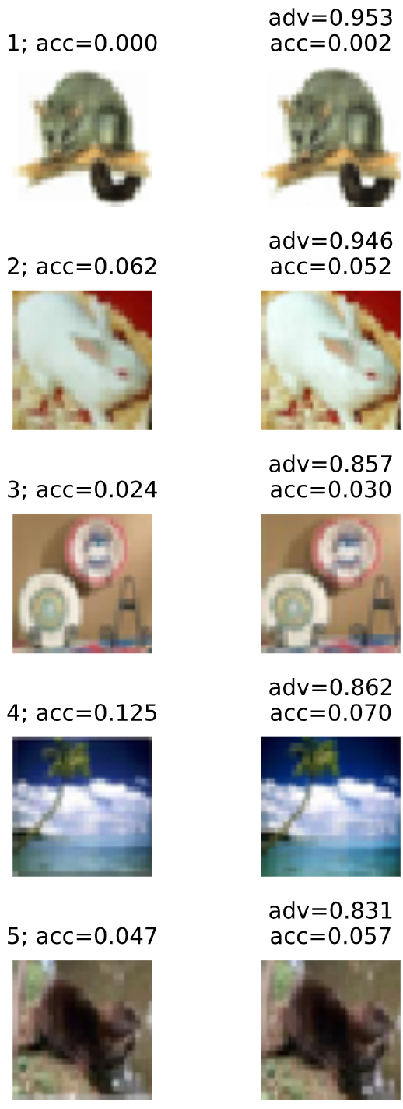
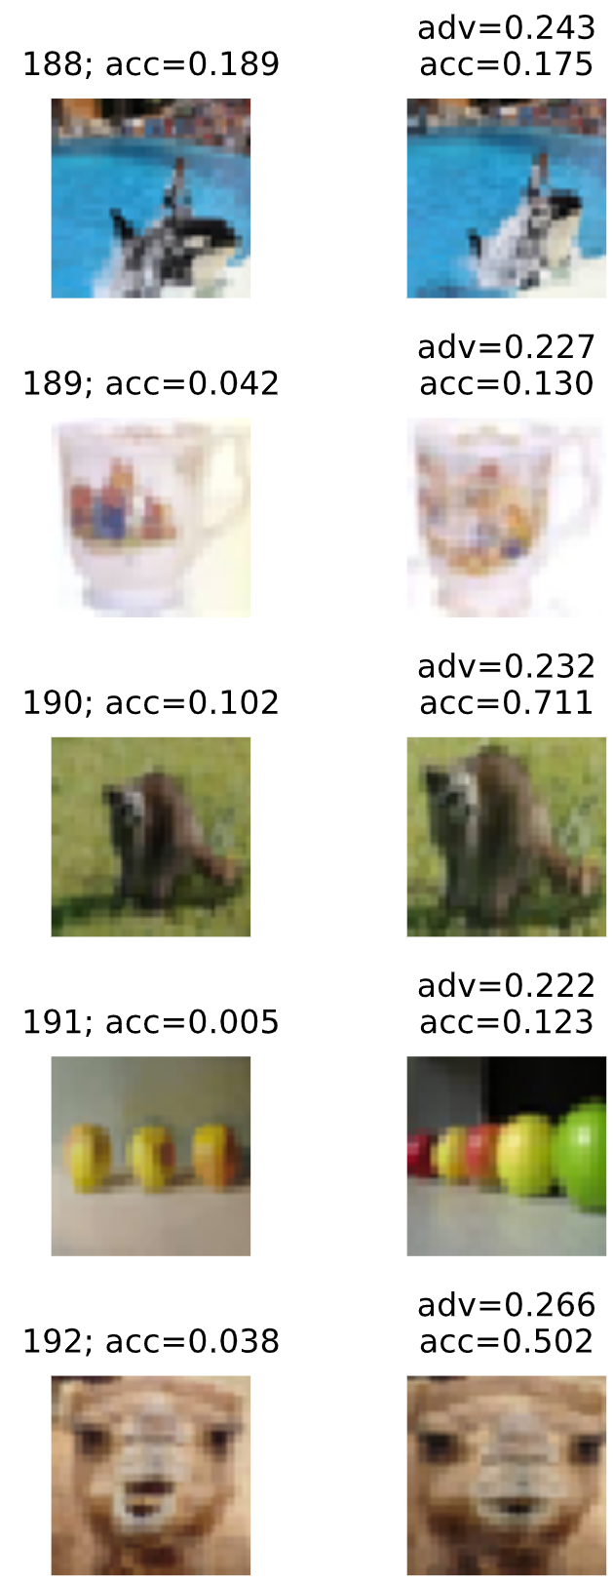
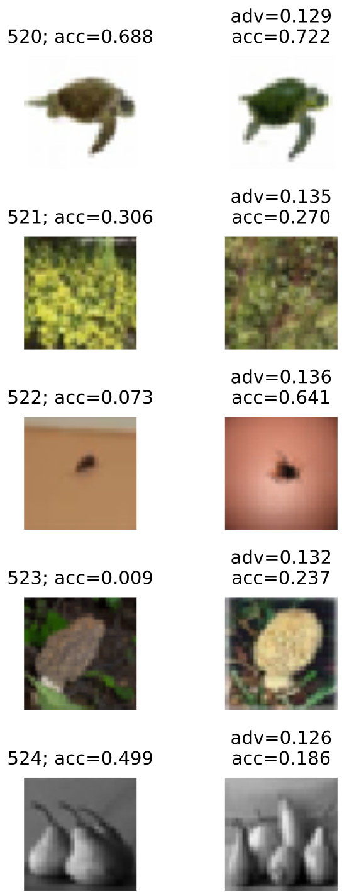
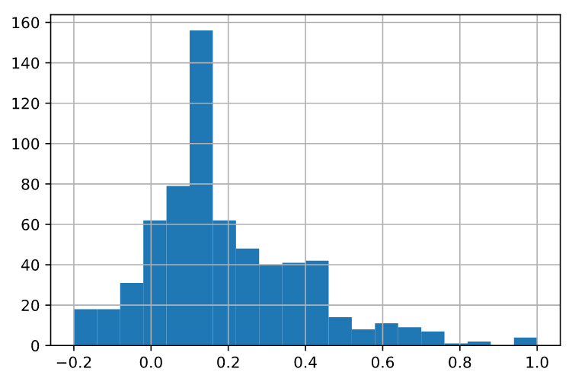
Results (CIFAR-100)
train
test
train
test
train
test
CIFAR-100:
50,000 train; 10,000 test
100 classes
Algo: SGD on Inception
62+% accuracy
700+ examples with
>10% advantage

Slide 22
Conclusions
Label memorization is not explained by prior work
New theory: long-tailed subpopulation frequencies
Memorization is necessary for optimal generalization
Not algorithm specific
Future work
More faithful theoretical models
Insights for better learning algorithms
Implications for privacy and fairness

